Slide 1
Credit Card Transactions & ML Classifier Models
Emma Spradbrow
Joshua Penny
Andres Geronimo

Slide 2
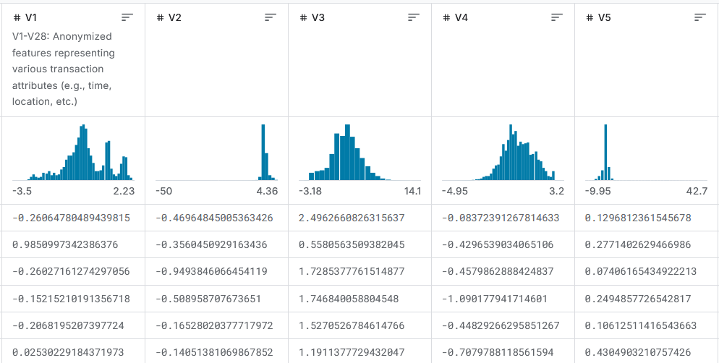
Working with anonymized datasets
Models found in Colab work with anonymized datasets
Notes:
Describe the problem with current classifier models and the lack of feature engineering in anonymized dataset.

Slide 3
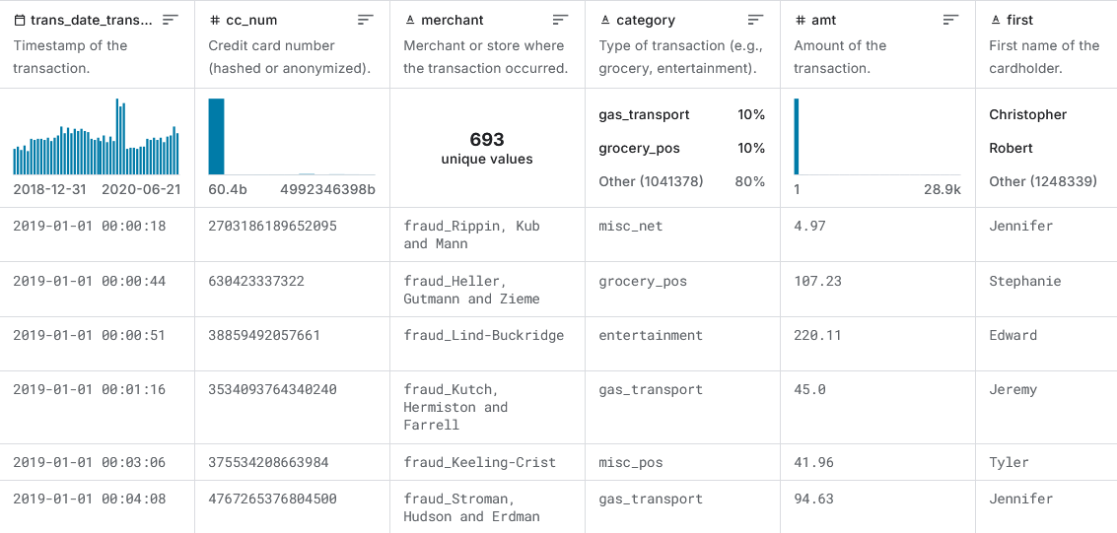
Credit Card Transactions Dataset Overview
If we could manipulate the features, what would we do differently?
https://www.kaggle.com/datasets/priyamchoksi/credit-card-transactions-dataset/data

Slide 4
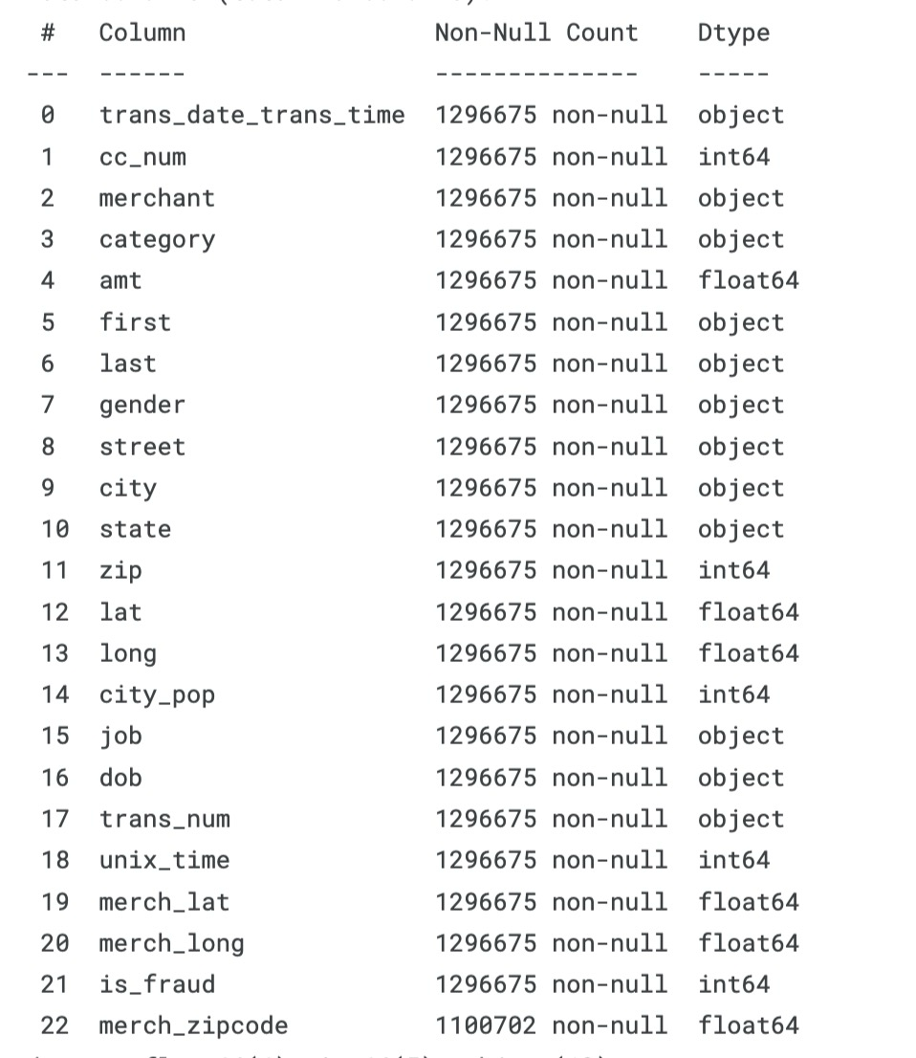
Data Analysis
1.3 million records
23 features
Notes:
so we are working with a fairly large dataset. 1.3 millions records and 23 features.
- transaction time,
credit card numbers, merchant name, category, transaction amount, and some card holder information

Slide 5
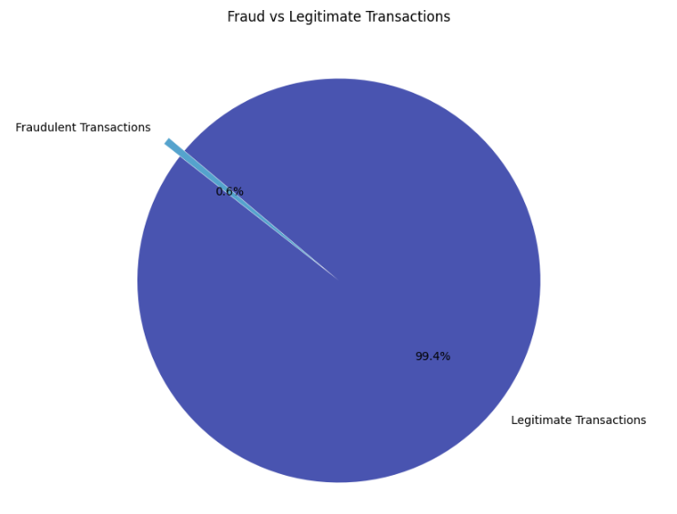
Dataset Imbalance - Fraud vs Non-Fraud
Notes:
First we needed to see what kind of data we're working with, as you can tell it is heavily skewed in the non-fraud case.
This means that accuracy isn't the best metric to go by for this case, because if we take a baseline model of just returning non-frraud, it's accuracy would be over 99%, but have terrible metrics for the fraud case.
There are some techniques to balance the data when training the model, but we'll provide some more details on those techniques later.

Slide 6
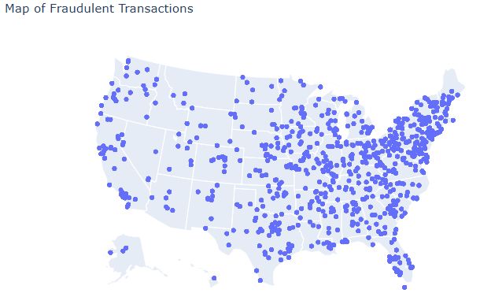
Data Analysis
Notes:
this is a map of the locations of the fraud cases.
Because the dataset had longitude and latitue we wanted to see where the data was generally taken from. I thought maybe there could have been a location bias, but that's not really seen, additionally we mitigate that potential in our feature engineer by changing the location to be the distance between cardholder and merchant.

Slide 7
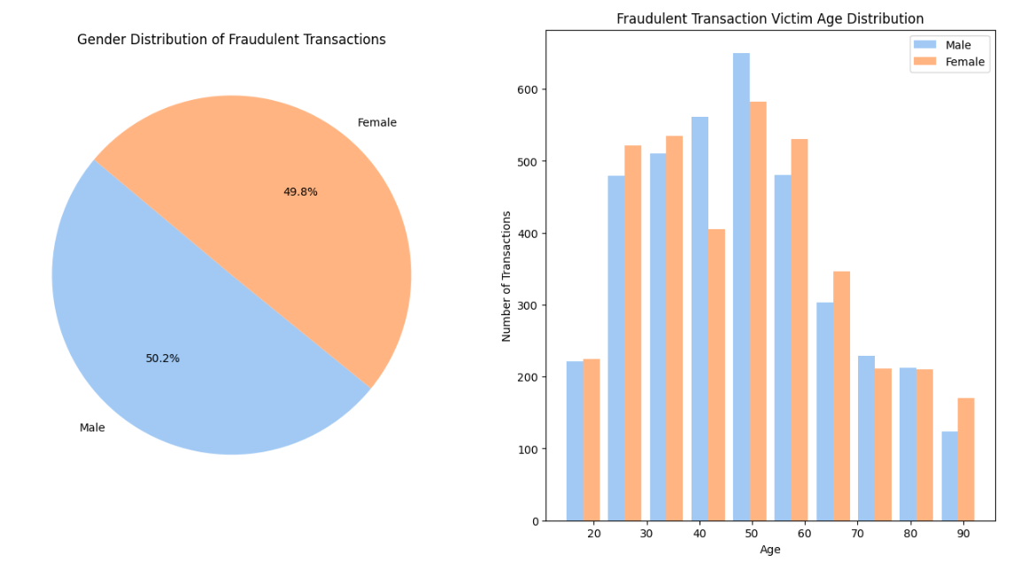
Data Analysis - Gender Distribution
Notes:
For the next slide we looked at the gender and age distribution on the data set, it's a fairly even split between male and female, and the bar graph shows a fairly regular distribution.

Slide 8
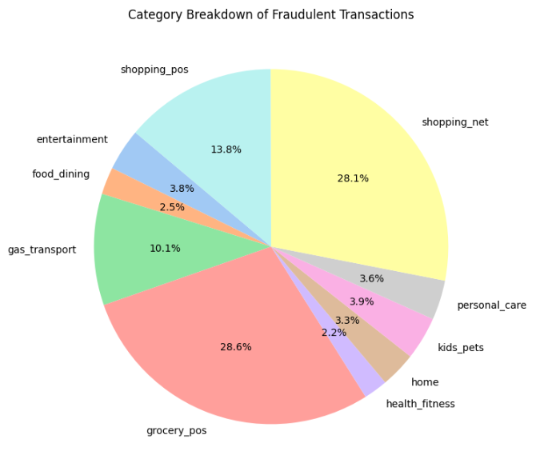
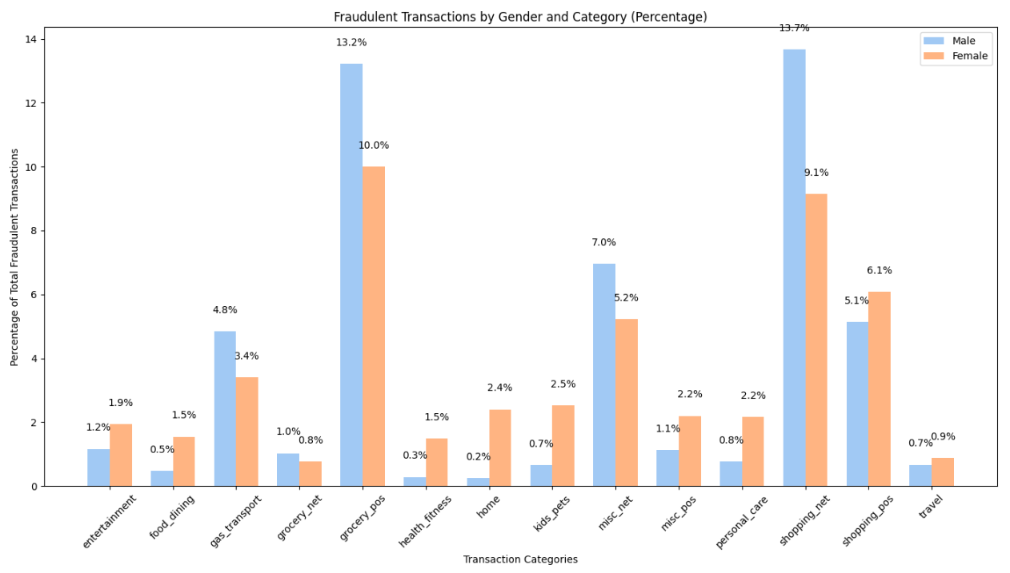
Data Analysis - Top Categories of Fraud Transactions
Notes:
This slide looks at the Category breakdown of the fraudulent case.
The bar graph looks at gender distribution per category. The pie chart on the right show the percentage of the fraud cases per category. You can see the top one is grocery point of sale, online shopping and general shopping point of sale.

Slide 9
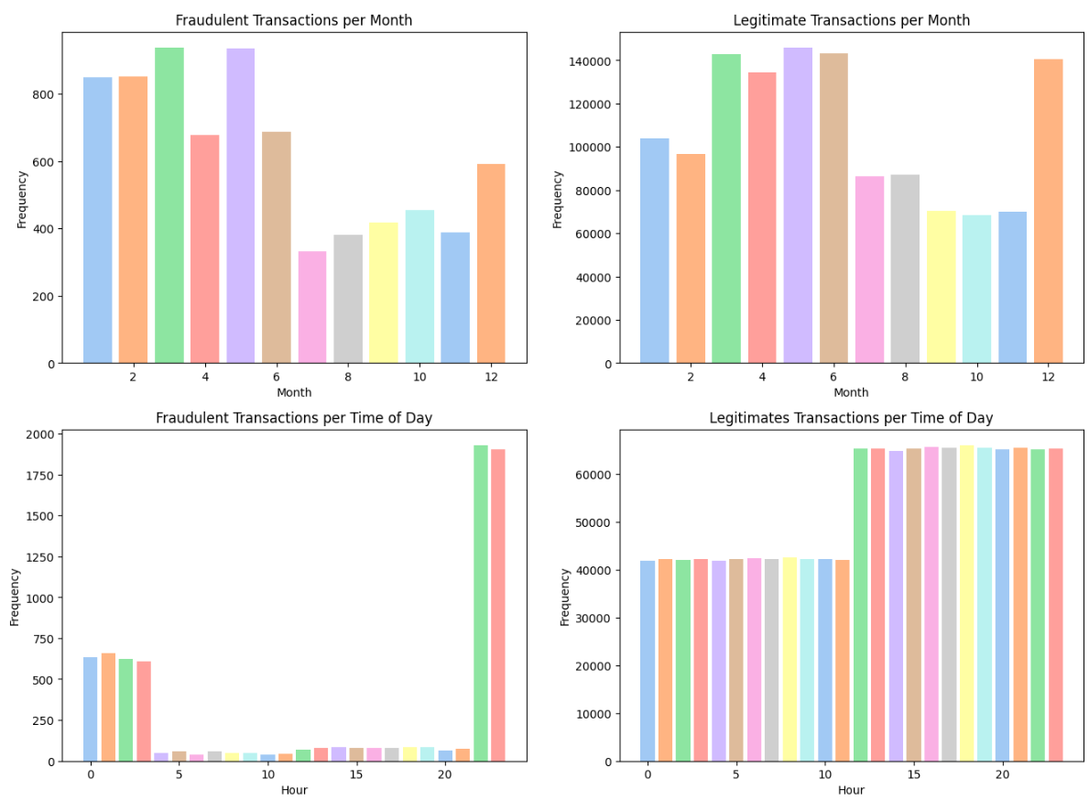
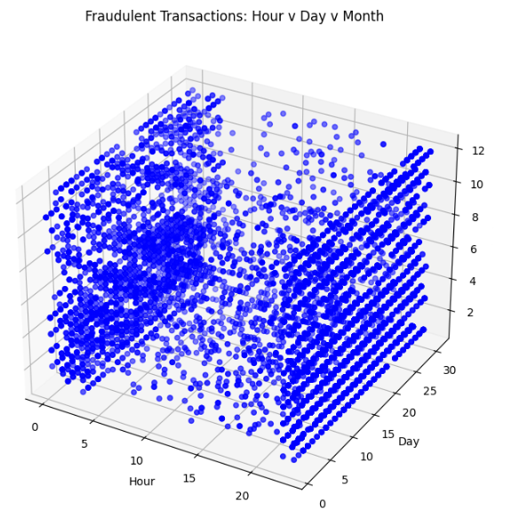
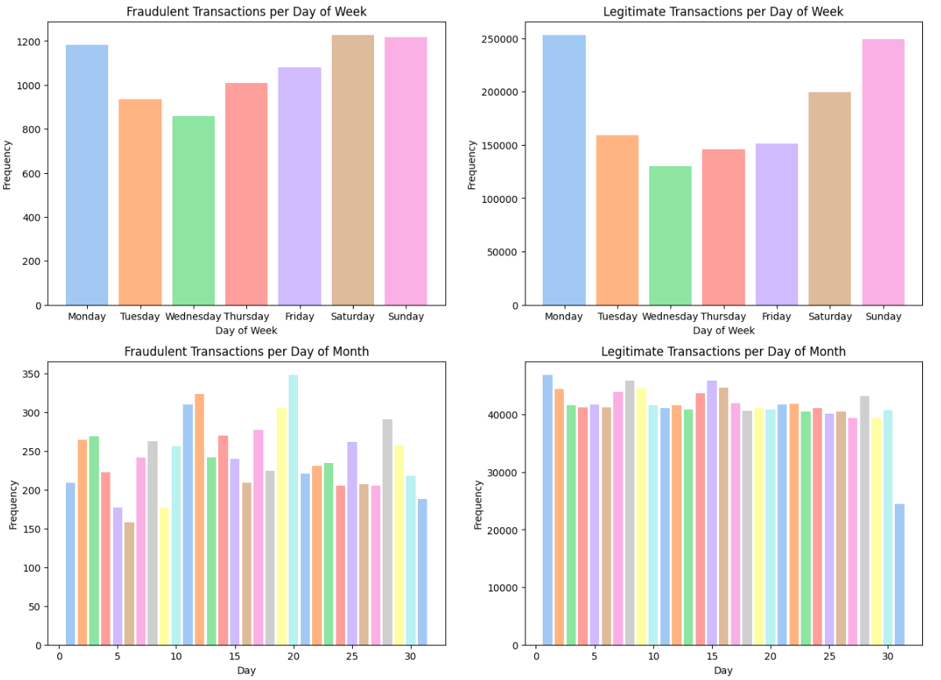
Data Analysis - Fraud Transactions over Time
Notes:
So for this one i wanted to see if there was a pattern in when the fraudulent transactions occurred.
There are 8 bar graphs, the ones on the left, look at the fraud cases, and the ones on the right are of the non-fraud cases.
The first one looks at number of transactions per month.
The second one looks at the hour time of day. You can see majority of the fraud cases occur between 11pm and 3 am. For the non-frraud transaction you can see that there are more transactions in the afternoon.
The third one looks at day of the week, it's a fairly similar distribution as the non-fraud case though.
The last one is day of the month, nothing too interesting on that one.
The 3d scatter plot on the right shows hour, day, month of the fraud transactions. Again you can see they it is much more dense around 11pm and midnight as well you can see it's more densely populated bottom left side of the cube.

Slide 10
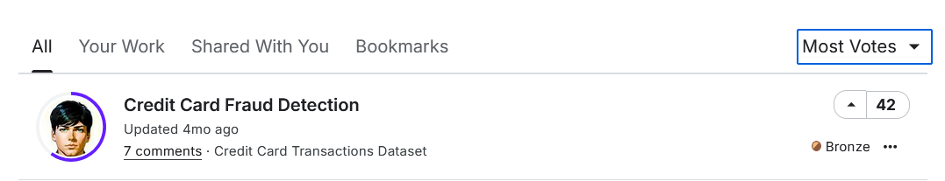
Colab Notebook Overview
Pavan Kumar’s Notebook working with the Credit Card Transaction Dataset
Notes:
https://www.kaggle.com/code/pavankumar4757/credit-card-fraud-detection/notebook

Slide 11
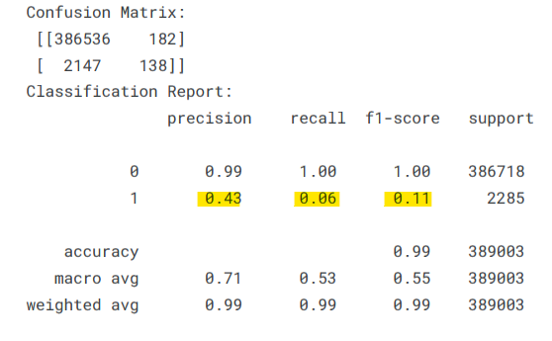
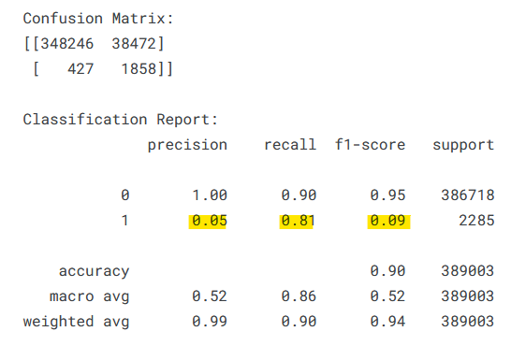
Colab Notebook Overview
Scores with imbalanced dataset
Scores After SMOTE

Slide 12
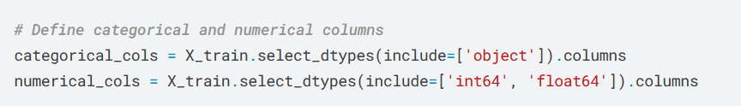
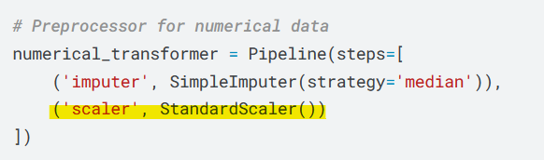
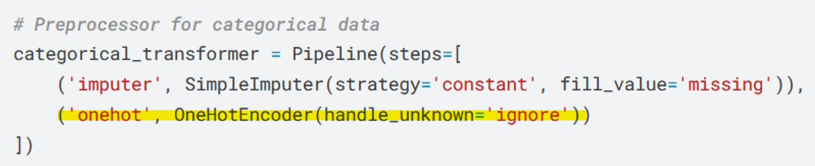
Colab Notebook Analysis - Feature Engineering Errors
Splits data types between categorical and numerical
Standardizes all numerical features
Transforms categorical features into a one-hot encoded array.
Notes:
Standard Scaler involves standardizing your data so that each numerical feature has a mean of zero and a standard deviation of one.

Slide 13
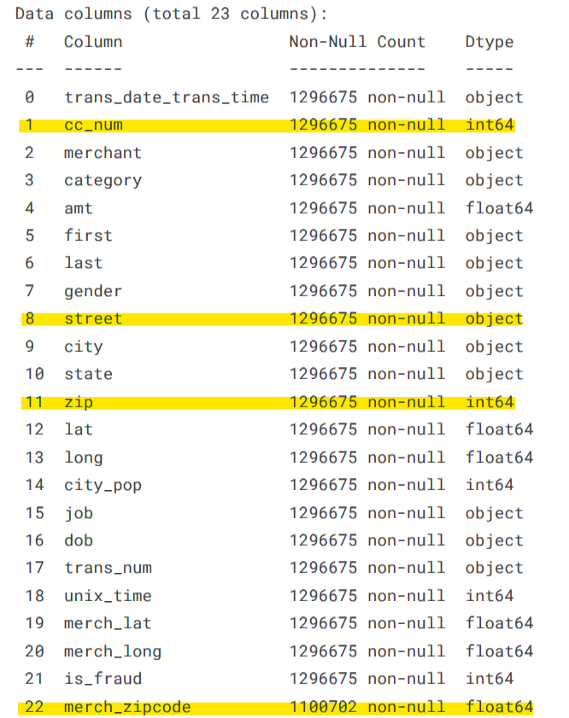
Colab Notebook Analysis - Feature Engineering Errors
Numerical and Categorical features that should not be standardized or encoded

Slide 14

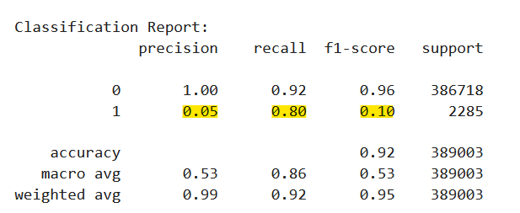
Logistic Regression Model Comparison
Pavan’s Original Score
Score After Feature Engineering
Notes:
Techniques tried:
SMOTE to rebalance the dataset
Parameter adjustment Finding the Optimal Threshold by plotting the ROC curve
Feature Engineering:
Removing cc_num and the zip codes from the numerical features
Removing Street from the categorical features

Slide 15
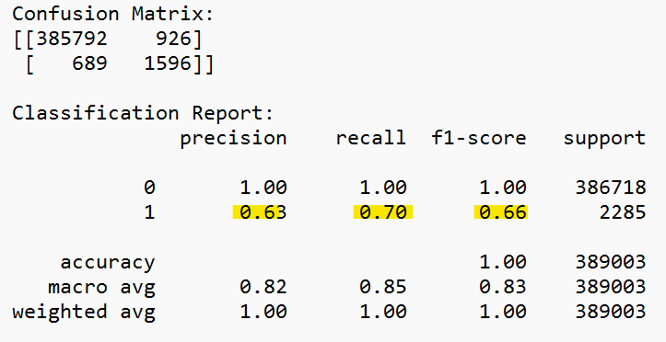
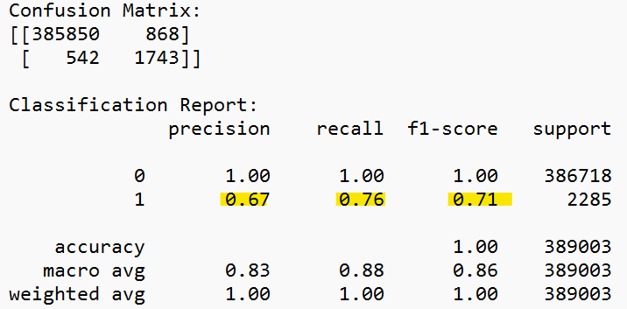
Decision Tree and Random Forest Models
Decision Tree
Random Forest
Notes:
We knew that we were heading in the right direction when we tried a Decision Tree model, and subsequently a Random Forest

Slide 16
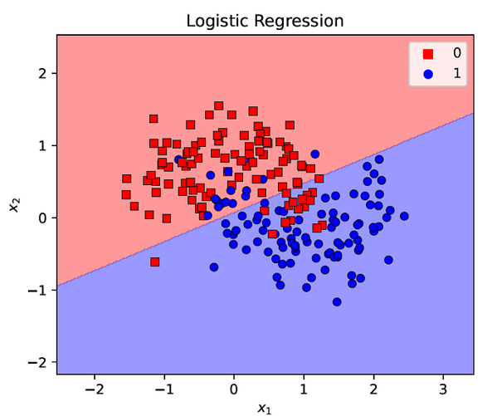
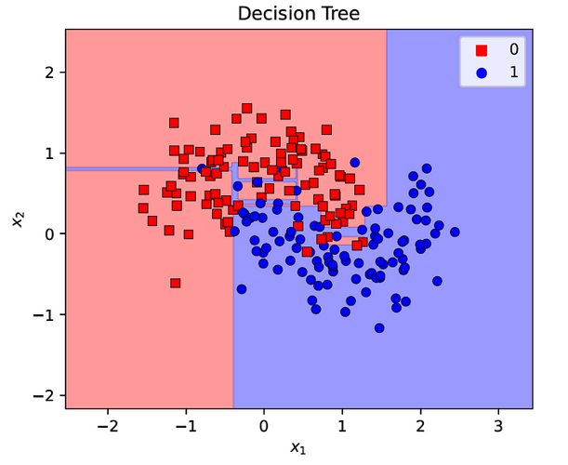
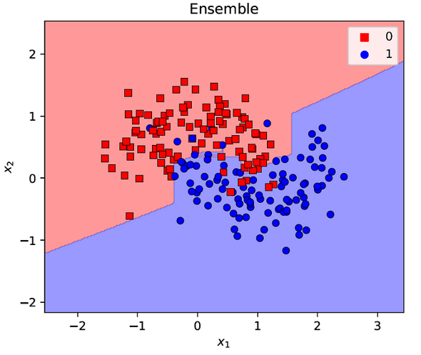
Logistic Regression vs Ensemble Methods
Illustration of different models and their decision boundaries
Yehoshua, R. (2023, August 9). Introduction to ensemble methods - towards AI. Medium. https://pub.towardsai.net/introduction-to-ensemble-methods-226a5a421687
Notes:
Logistic regression is a linear model at its core—it assumes a linear relationship between the input features and the log-odds of the target. In contrast, ensemble methods (like random forests or gradient boosted trees) naturally capture non-linear relationships and complex feature interactions.
Ensemble Methods provide:
Better Generalization on Complex, Imbalanced Data
Adaptive and Iterative Refinement (Boosting):
Boosting algorithms iteratively improve their predictions by focusing on the most challenging examples.
Robustness Against Outliers and Noise:
Real-world credit card transaction data can be messy, with outliers, missing values, and noisy patterns.

Slide 17
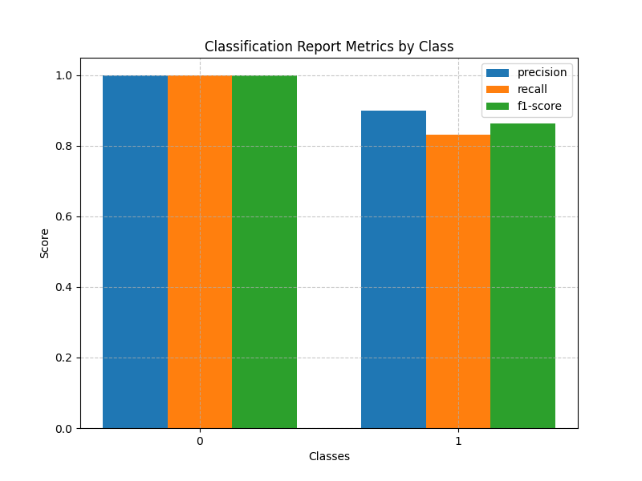
XGBoost Model Performance
eXtreme Gradient Boosting
Precision: 0.9
Recall: 0.83
F1: 0.86

Slide 18
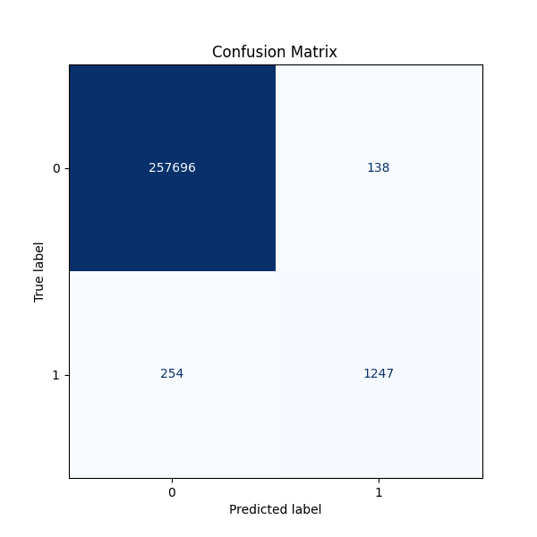
XGBoost Model Performance
eXtreme Gradient Boosting
Precision: 0.9
Recall: 0.83
F1: 0.86

Slide 19
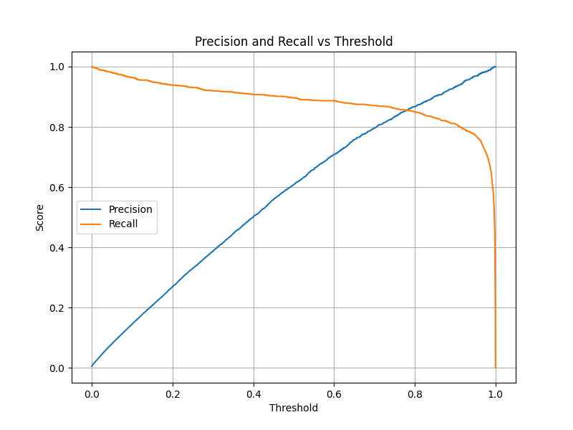
XGBoost Model Performance
eXtreme Gradient Boosting
Precision: 0.9
Recall: 0.83
F1: 0.86

Slide 20
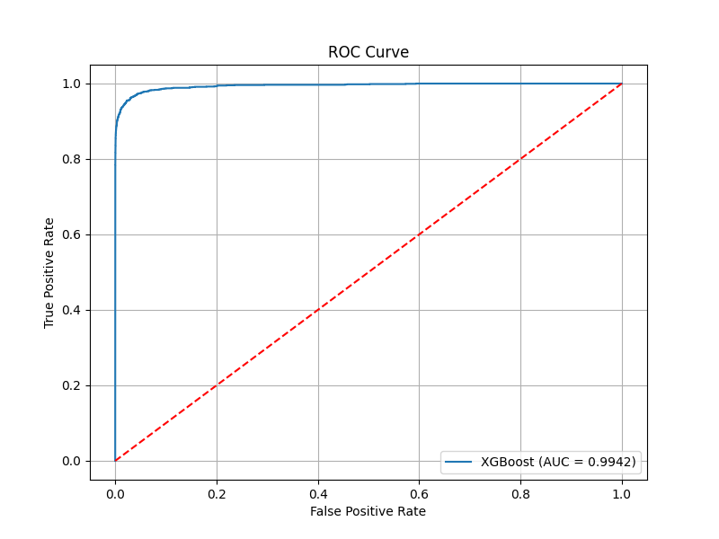
XGBoost Model Performance
eXtreme Gradient Boosting
Precision: 0.9
Recall: 0.83
F1: 0.86

Slide 21
Feature Engineering
Dropped unnecessary features
Extracted hour/day/month/day-of-week
Calculated age
Dropped dob and trans_date_time
Hashed cc_num
Calculated transaction count per credit card

Slide 22
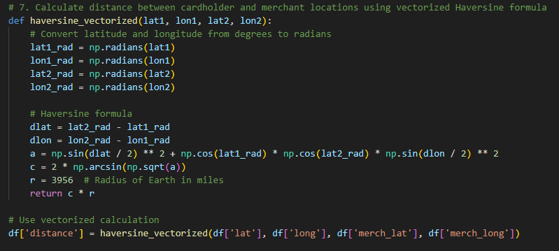
Feature Engineering
Used the vectorized Haversine formula
Dropped original lat/long
Limited categories and state to top 10
Binned city_pop into sizes
Used standard scaling

Slide 23
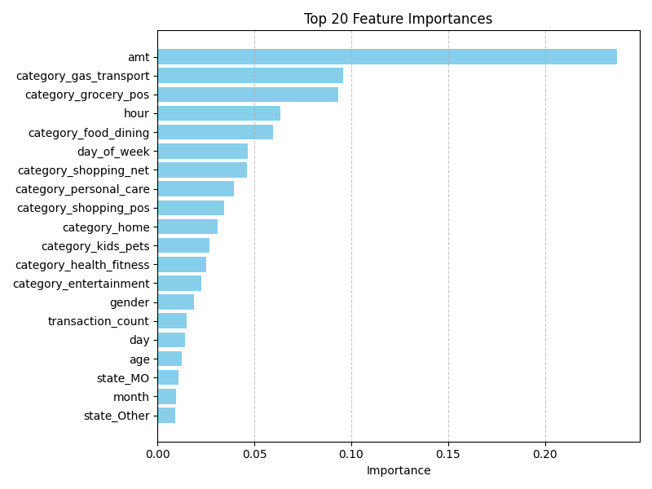
Feature Engineering

